Slide 1
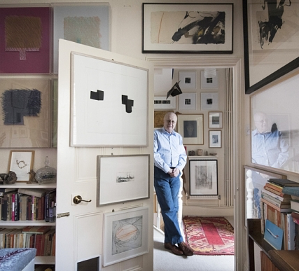
Digital Téchne for public & private COLLECTIONS
To uniquely "tag" your Collection.​
Your collection data is auto-updated​
Your digital Vault is secure​
You can share artworks with your friends on your laptop.​
Be sure about the origin and history of the art goods you own/buy.​
Demonstrate the authenticity and provenance of works, increasing their economic value​
Your privacy is protected, and you remain completely anonymous​​

Slide 2
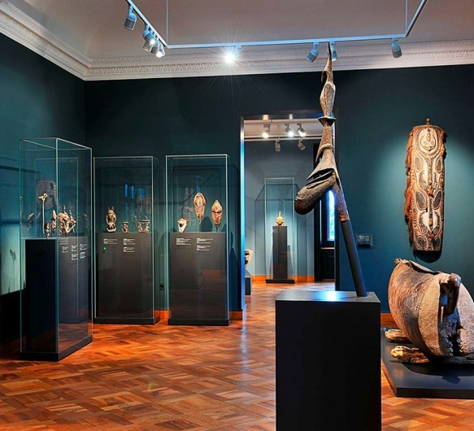
Digital Téchne for AUCTION HOUSES
You can access and track your artwork at any time, your privacy is protected, and you remain completely anonymous.
Our Certificates create a digital provenance that records artwork designed to last for centuries.
Documentary compound
Our solutions include paperless labels, transfers, and invisible labeling systems.
You can share artwork with your clients anywhere on your digital devices.​
Be sure about the origin and history of the art goods you own/buy.​
PoA, Proof of Authenticity, demonstrates the authenticity and provenance of works, increasing their economic value​
Add multiple colleagues to your account for free and assign them the appropriate permissions to manage the portfolio.
Your digital Vault is secure​
We offer our clients personalized advice to protect them from fraud and counterfeiting.

Slide 3
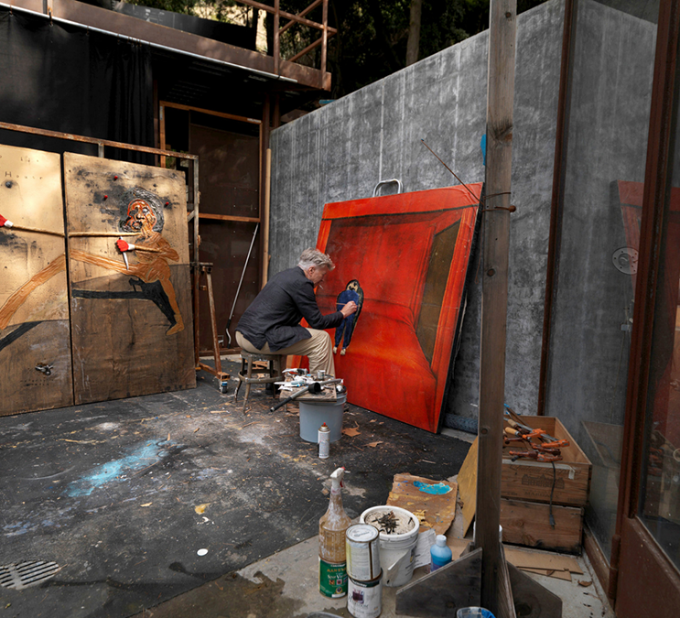
Digital Téchne for ARTIST’s
Register your Artwork ​
Provide your customers with a reliable and verifiable certification of authenticity.
Expand your market to potential customers eager to invest in art.
No more concerns about possible fakes

